Slide 1
Week 2: The Demand for Health Care
UMUC HMGT 435

Slide 2
Key Learning Objectives Week 2
How to interpret a demand curve
Understand why demand curve is “generally” downward sloping
Learn about elasticity of demand and what that means
Identify factors that lead to a change (shift) in demand
Understand how “substitutes” and “complements” impact demand
Identify unique characteristics of health care relative to other goods
  Healthcare as an Investment
  Elasticity of Demand
  Asymmetric (Imperfect) Information

Slide 3
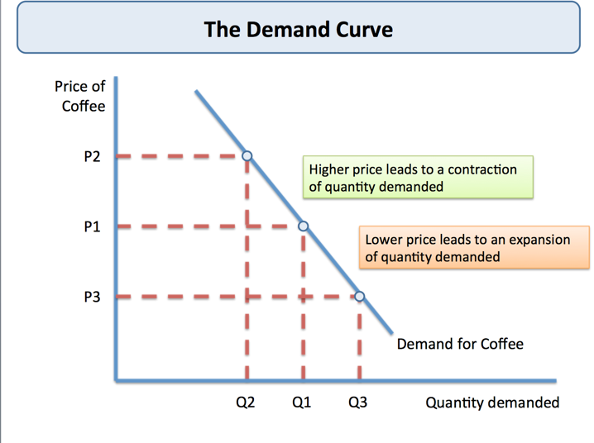
What is the Individual Demand Curve?
Shows relationship between the price of a good and the quantity demanded (holding all else constant)
Demand is defined for a “specific time period.”
Higher price leads to lower quantity demanded and vice versa (downward sloping)

Slide 4
Why is Demand Curve Downward Sloping?
For “normal goods” demand curve is downward sloping because the quantity demanded falls as prices rise (holding all other conditions constant)
  Note movements along the demand curve represent changes in quantity demanded due to changes in price while shifts in the demand curve represent changes in demand.
The demand curve is the Marginal Benefit curve that shows how much each “additional unit” of a service is worth.
  Later you will learn that the supply curve represents the marginal cost of a good.
The “slope” (e.g. steepness) of the demand curve is determined by the sensitivity of consumers to the price of the good (often called price elasticity)

Slide 5
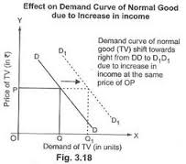
What Leads to A Shift in Demand Curve
Factors that Lead to An Increase in Demand (shift D curve right)
  Increase in Consumer income
  Price of related goods ( increase P substitutes or decrease P of complements)
  Changes in consumers tastes and advertising
  Consumer Expectations about future prices (e.g. expect prices to increase in future)

Slide 6
What Determines the Demand Curve
Consumer choice theory explains why consumers behave or react in certain ways to changes in various factors to “maximize their utility”
Utility is illustrated using “indifference curves” showing a consumer’s preferences across different good.
An “indifference curve” shows what combination of two good that yield equal satisfaction.
Slope (steepness) of indifference good shows the “marginal rate of substitution.” This is the amount of one good that must be sacrificed to get the other good.
Diminishing Marginal Utility: At some point, if you keep consuming a good, your utility diminishes (e.g. eating too much candy)
Consumption is constrained by both the price of the good and their income.

Slide 7
What Does Price Elasticity Mean?
Elasticity measures how sensitive quantity demanded is when prices change.
Mathematic Formula:
  Price elasticity = % change in quantity/% change in demand
Graphically:
  The slope (steepness) of the demand curve indicates elasticity of demand
  The steeper the slope the more inelastic demand is
  The flatter the slope the more elastic demand is

Slide 8
What Does Price Elasticity Mean?
“Price Elastic”
  Quantity demanded will change by more than change in price. This indicates that consumers are “very sensitive” to price changes.
“Price Inelastic”
  Quantity demanded will change by less than the change in price
  *** Many health care goods are price inelastic and not sensitive to price changes****
“Unit Elastic”
  Quantity demanded changes by the same percentage as price changes

Slide 9
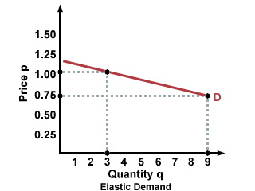
When Demand is Price Elastic
High P elasticity (>1) means that consumer are more “sensitive” to changes in price
A small change in price leads to a larger change in quantity
Can you think of healthcare goods that are price elastic?

Slide 10
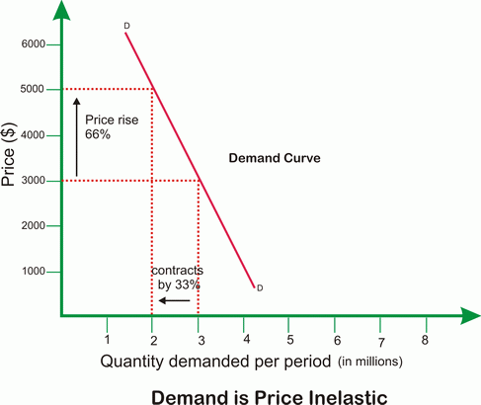
When Demand is Price Inelastic
Low P elasticity (P is inelastic) and < 1 means consumers are “not sensitive” to changes in price
Inelastic: % change in Q < % change in P
Can you think of healthcare goods and services that are price inelastic?

Slide 11
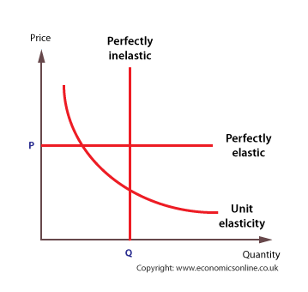
Elasticity in the Extreme
Perfectly Inelastic: Quantity demanded does not change when price changes (e.g. lifesaving drugs)
Perfectly Elastic: At a certain price quantity demanded is infinite, if a firm increased price by 1% all of its demand would evaporate (e.g. good with large number of substitute)

Slide 12
Impact of Substitute Goods on Sensitivity of Demand to Prices
A “substitute” is a good used in lieu of another good that functions similarly or provides the same service.
The availability of a “substitute” for a good impacts the price sensitivity or elasticity
Demand for a product will be “relatively elastic” (more sensitive to price) if there are a large number of substitutes for the product
“Antacids” Example: There are many different substitutes for antacids. Demand for “Tums” may decrease if price of Tums increase and price of Prilosec decreases.

Slide 13
What are Complementary Goods
A “complement” is a good used in conjunction with another good.
Example: Gauge and Tape used to cover a wound. If you use gauge you also need tape to hold the gauge to the wound.
An increase in the price of the complementary good, reduces the demand for the good you are focusing on.

Slide 14
Other Determinants of Price Sensitivity (Elasticity)
Share of Consumer’s Budget
  The larger the share of a good is of a consumer’s budget (like food), the more sensitive (elastic) the consumer will be to changes in price
Luxury Goods vs. Necessity
  The more discretionary a good is (like a diamond necklace), the more sensitive (demand is more elastic) a consumer is to prices
  The more a good is a necessity (e.g. insulin for a diabetic patient), the less sensitive (demand is more inelastic) a consumer is to prices

Slide 15
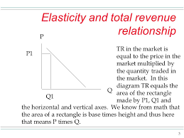
Price Elasticity and Total Revenue
Total Revenue = P times Q
Thus, elasticity or sensitivity of demand to price impacts impact on total revenue
TR will decline by a smaller amount when prices rise and demand is inelastic (see next slide)

Slide 16
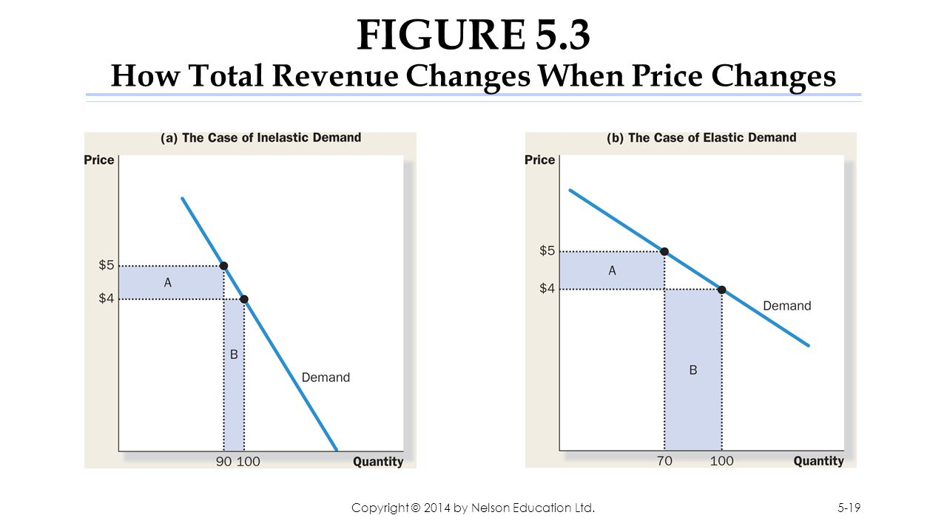
How Elasticity Impact Total Revenue

Slide 17
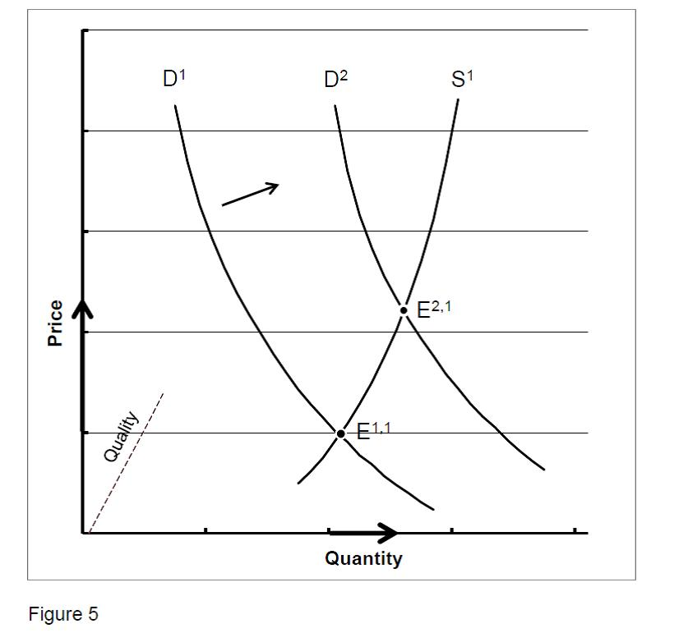
Need to See Supply Curve for Equilibrium Price
Demand is only one component of analysis
As price changes, producers (suppliers) are willing to produce more or less
Need to overlay supply curve on demand curve to identify equilibrium price
We will discuss more about supply and its characteristics in Week 4 and Week 5

Slide 18
Unique Characteristics of Demand for Health Care
Investment Component as well as Consumption Component
Demand for health care tends to be more inelastic (reasons discussed below)
Information is not readily available about quality of care and care plan (e.g asymmetric information)

Slide 19
Health Care as An Investment
Health care has both two characteristics:
  1) Consumption good, makes consumer feel better
  2) Investment commodity component– a state of health will determine the time available to the consumer to work and for leisure
Example Of Investment Component:
  A decrease in the number of sick days will increase the time available for work and leisure
  The Return to Investment on health is the monetary value of the decrease in sick days
Implications for Demand – Include a “time” component that impacts demand for health care

Slide 20
Health Care As An Investment (Cont.)
Investment in health care is costly as consumers must trade off time and resources devoted to health, such as exercising at a local gym, against other goods.
Optimal Level of Investment in Health is:
  Marginal benefit = Marginal cost
  Because as we age, health depreciates so it becomes more costly to attain the same level of health capital or health stock as one ages
  Age also decreases the marginal benefit of health
  Optimal health investment will therefore decrease as we age
Source: Michael Grossman (1972), “On the Concept of Health Capital and the Demand for Health” Journal of Political Economy, 80(2): p 223-255

Slide 21
The Elasticity of the Demand for Health Care
Existence of health insurance reduces the exposure of insured individuals to the price of health care
  Reduces the elasticity of demand for health care services
Out-of-pocket costs play a larger role in influencing patients
Big push for “high-deductible” health plans intended to increase the price sensitivity of individuals when consuming health care services
For the uninsured, the “need” for care reduces sensitivity to prices

Slide 22
Asymmetric Information in Health Care
Doctors are better informed about health care and the health care needs of their patients
A “principle-agent” relationship develops in which the doctor (the agent) makes available their specialist knowledge to the principle (the patient)
Problem is end up with “supplier induced demand”
  Doctors act as imperfect agents (failing to maximize the patients’ utility) in order to maximize their own utility. Hard to measure this.
  Example: Doctor owns the lab, he has incentive to order blood tests to increase the profit of the lab. A number of laws exist to prevent these relationships.
Source: Kenneth Arrow (December 1963), “Uncertainty and the Welfare Economics of Medical Care,” American Economic Review, 53 (5) p.941-973

Slide 23
In This Week’s Readings
Be sure to read and understand the article in this week’s reading:
  Monitoring Health Spending Increases: Incremental Budget Analyses Reveal Challenging Trade-offs by Hartman, et al.
After reviewing this article what is the key trade-off our nation faces as the share of our nation’s GDP is spent on an ever-increasing health care budget?
Can health care increase indefinitely at current rates?
Why or why not?

